Slide 1
Nerve Impulse and Muscle Contraction

Slide 2
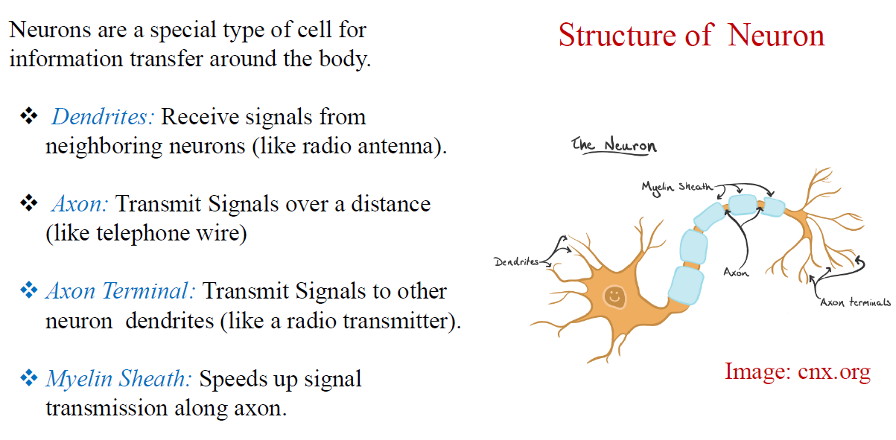

Slide 3
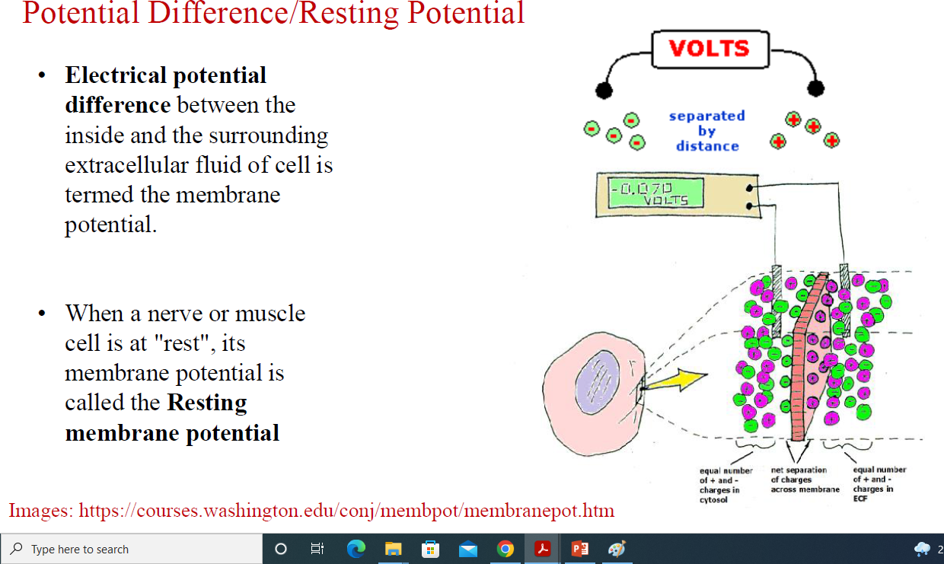

Slide 4
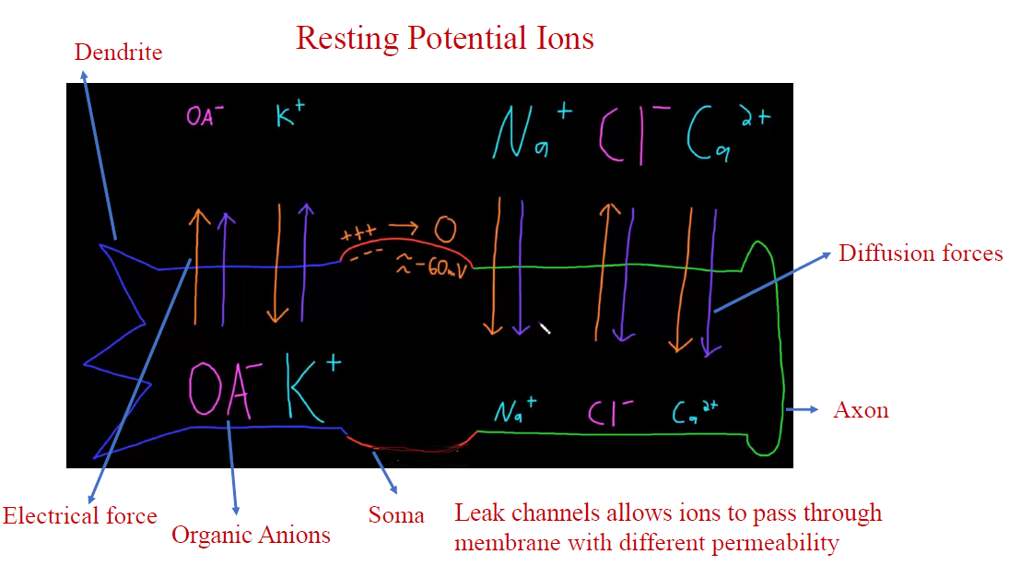

Slide 5
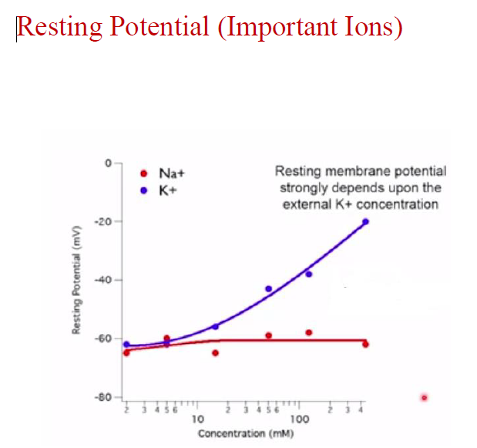

Slide 6
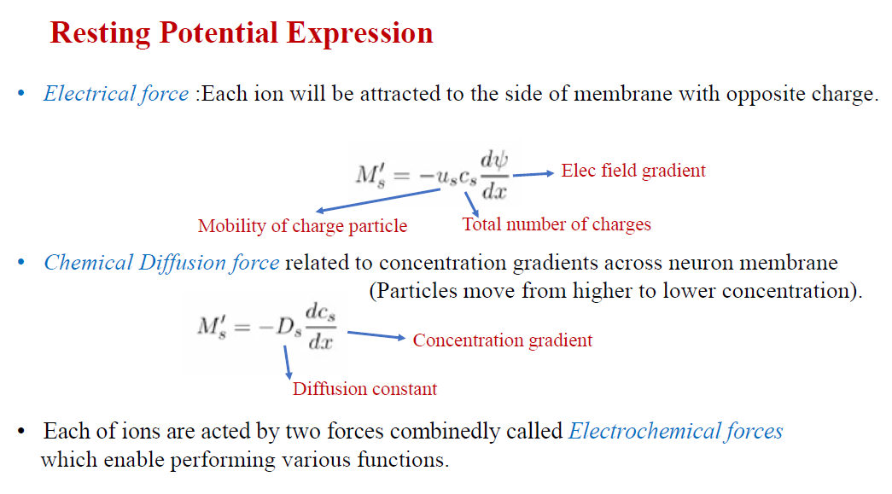

Slide 7
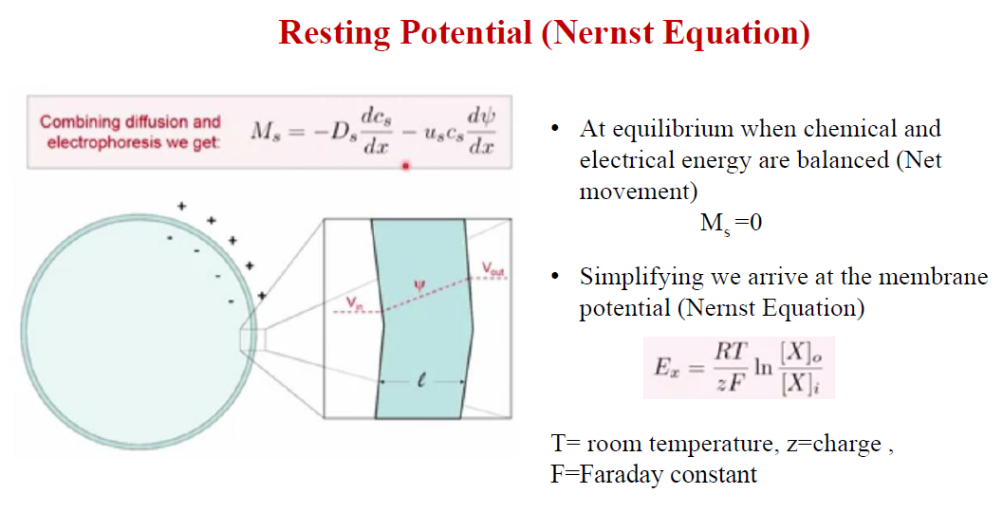

Slide 9
Study how 100 billion Neurons are firing of nearly 50 action potentials per second thereby controlling what we do, how we think, move muscles, listen to lecture classes ☺

Slide 10
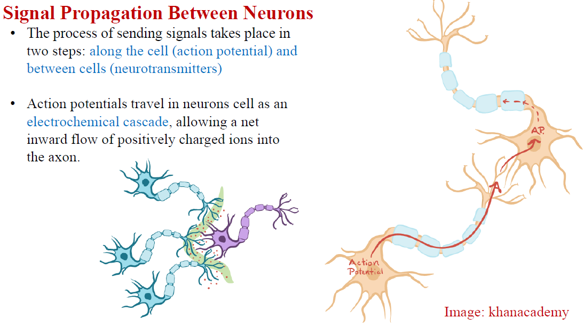

Slide 11
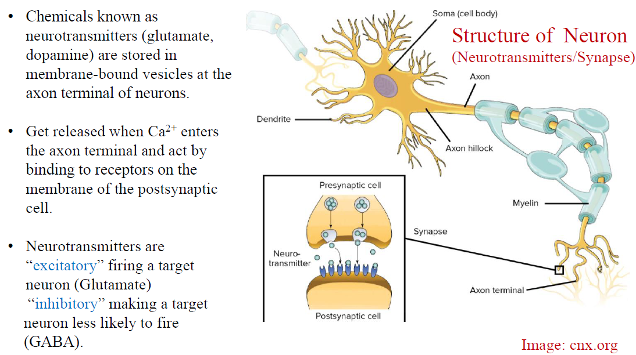

Slide 12
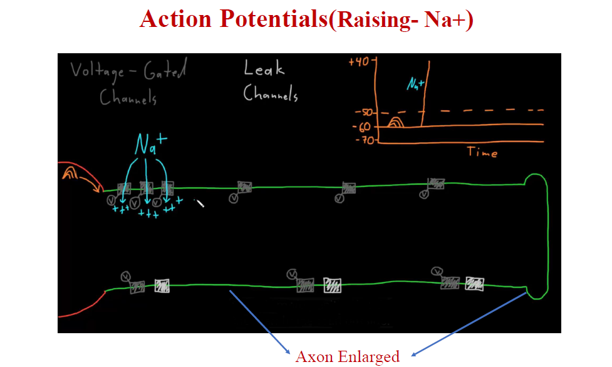

Slide 13
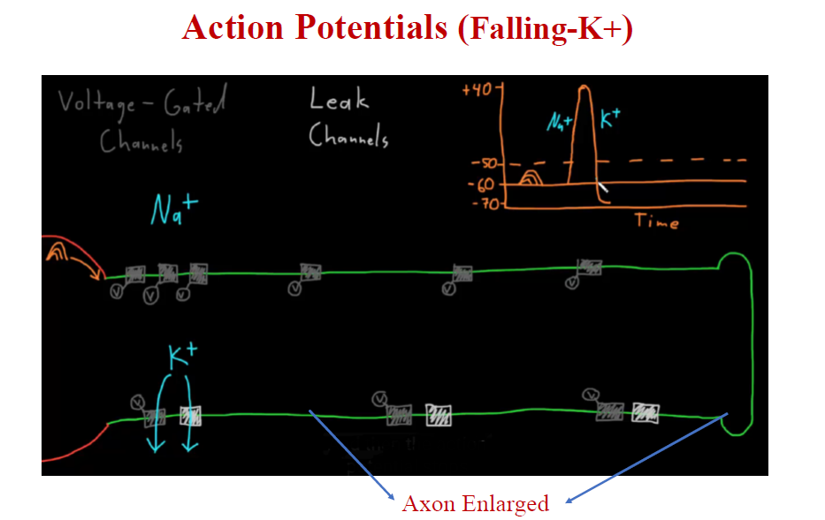

Slide 14
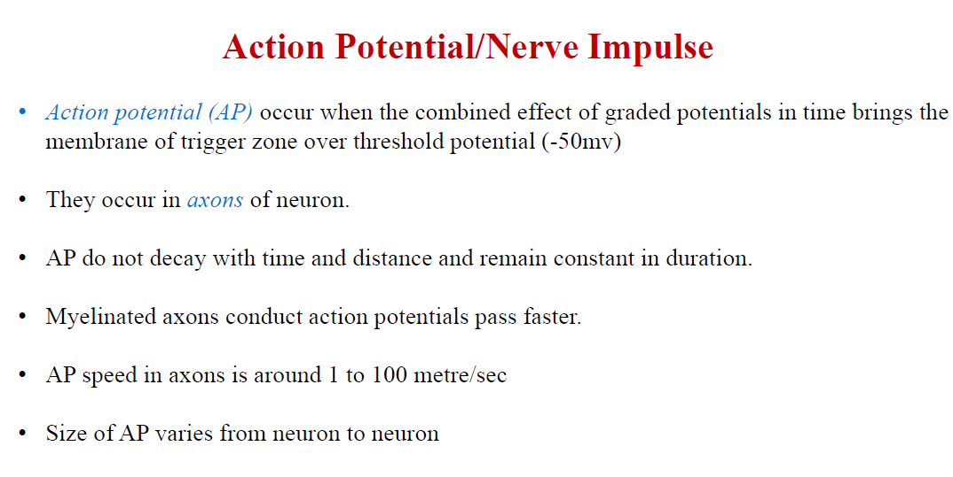

Slide 15
STRUCTURE OF MUSCLES
Muscle Innervation
What is the fundamental unit of Skeletal Muscle?

Slide 16
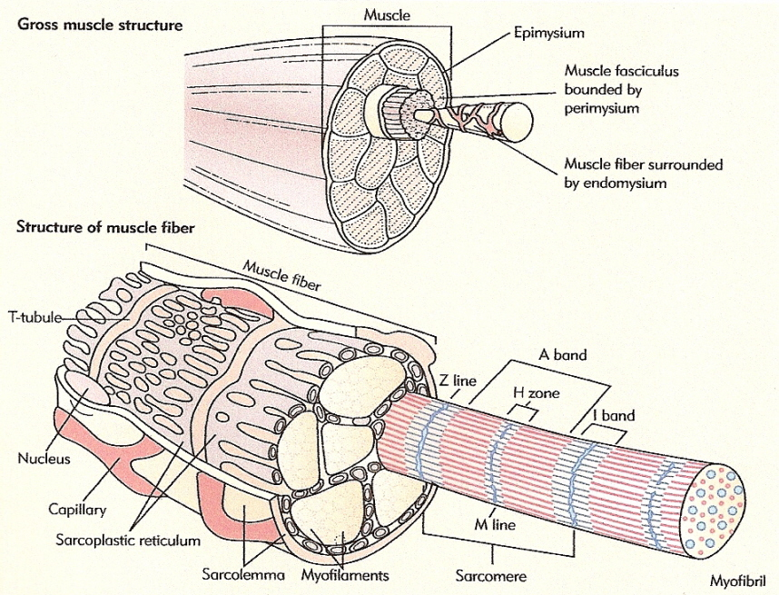
Skeletal muscles consist of numerous subunits or bundles called fasicles (or fascicles). Fascicles are also surrounded by connective tissue (called the perimysium) and each fascicle is composed of numerous muscle fibers (or muscle cells).
Muscle cells, ensheathed by endomysium, consist of many fibrils (or myofibrils), and these myofibrils are made up of long protein molecules called myofilaments. There are two types of myofilaments in myofibrils: thick myofilaments and thin myofilaments.
Skeletal muscles are usually attached to bone by tendons composed of connective tissue. This connective tissue also draws the entire muscle & is called epimysium.

Slide 17
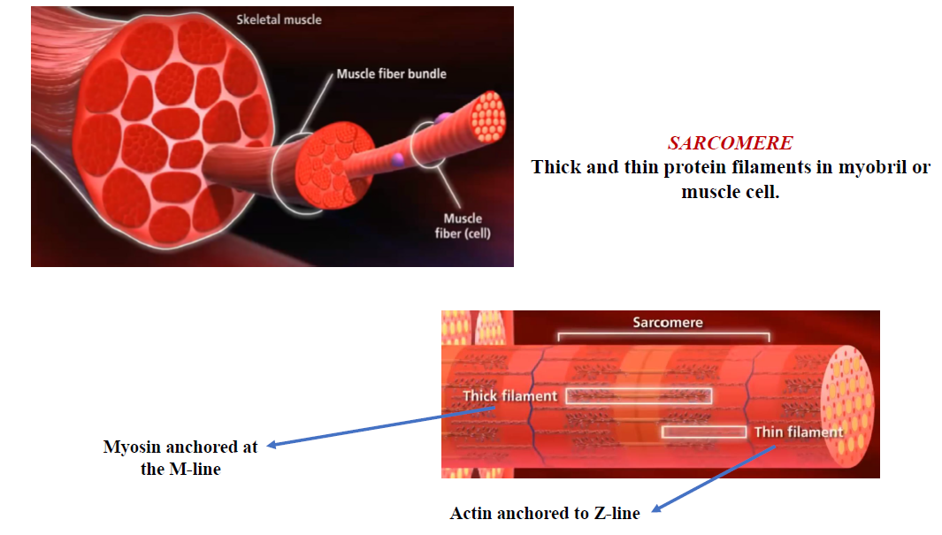

Slide 18
Interaction between actin and myosin

